Slide 1
Measures of Similarity and Dissimilarity
Dr.S.Lovelyn Rose

Slide 2
Data Set
Data Object 1
Attribute1
Attribute n
Data Object m
Attribute 1
Attribute n
…
…
…

Slide 3
Data Representation
Data matrix
Object x Attribute
Similarity Matrix
Object x Object
Dissimilarity Matrix
Object x Object

Slide 4
Data matrix
 | Attr 1 | Attr 2 | … | Attr j | … | Attr m
Object 1
Object 2
…
Object i
…
Object n

Slide 5
Dissimilarity matrix
 | Object 1 | Object 2 | Object 3 | … | Object i | … | Object n
Object 1 | 0
Object 2 | D(2,1) | 0
Object 3 | D(3,1) | D(3,2) | 0
…
Object i | D(i,1) | D(i,2) | D(i,2) | … | 0
…
Object n | D(i,1) | D(i,2) | D(i,2) | … | D(n,i) | … | 0

Slide 6
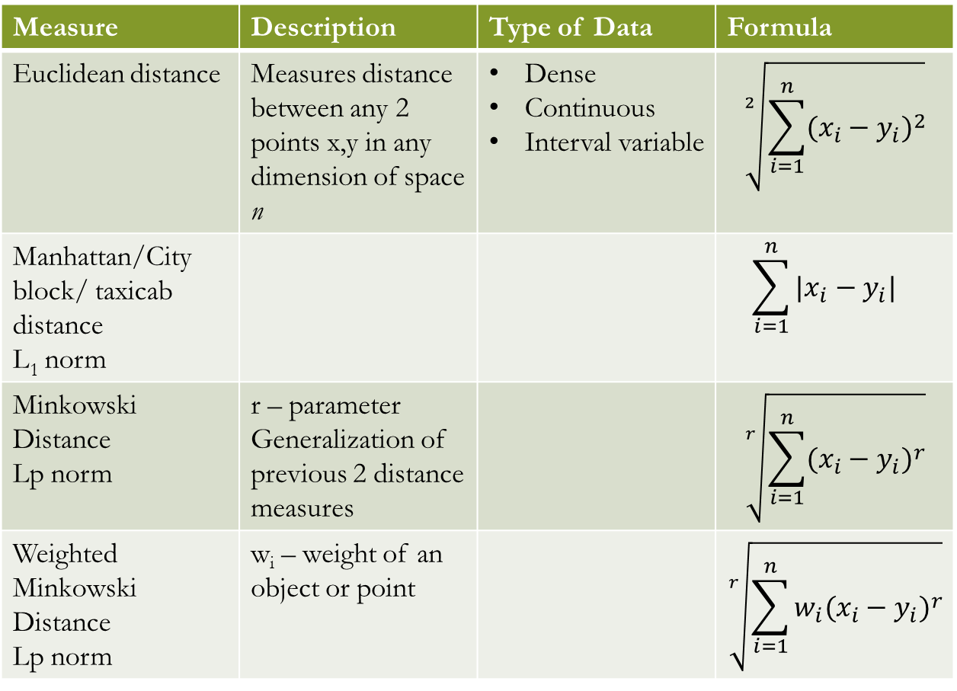
Measure | Description | Type of Data | Formula
Euclidean distance | Measures distance between any 2 points x,y in any dimension of space n | Dense Continuous Interval variable | $$\sqrt[2]{\sum_{i=1}^{n}{{(x_{i}−y_{i})}^{2}}}$$
Manhattan/City block/ taxicab distance L₁ norm |  |  | $$\sum_{i=1}^{n}{{|x_{i}−y_{i}|}^{}}$$
Minkowski Distance Lp norm | r – parameter Generalization of previous 2 distance measures |  | $$\sqrt[r]{\sum_{i=1}^{n}{{(x_{i}−y_{i})}^{r}}}$$
Weighted Minkowski Distance Lp norm | w_{i} – weight of an object or point |  | $$\sqrt[r]{\sum_{i=1}^{n}{w_{i}{(x_{i}−y_{i})}^{r}}}$$

Slide 7
Euclidean Distance
Find the Distance Matrix

Slide 9
Minkowski Distance
Distance Matrix

Slide 10
Dissimilarity/Distance Measure
A measure that satisfies the following properties
Positivity
d(i,j) ≥ 0
d(i,i) = 0
Symmetry
d(i,j) = d(j,i)
Triangle Inequality
d(i,j) ≤ d(i,k) + d(k,j)

Slide 11


Chebyshev Distance
Measure | Description | Formula
Infimum norm | This is the minimum difference between any component of the vectors
Supremum norm L_{max} norm L∞ norm | This is the maximum difference between any component of the vectors

Slide 12
Chebyshev Distance

Slide 13
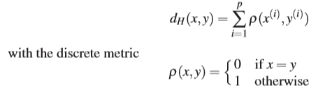
Hamming Distance
Value is the number of features that do not match

Slide 14
Example – Hamming Distance
T1: fifaforfootball
T2: fifaandfootball
What is the hamming distance?

Slide 15
Example – Hamming Distance
T1: fifaforfootball
T2: fifaandfootball
What is the hamming distance?
3 – ‘for’ and ‘and’

Slide 16
Disadvantages
The various forms of the Minkowski distance do not account for different metrics of the individual coordinates.
If the coordinates span different ranges, the coordinate with the largest range will dominate the results.
You therefore have to scale the data before calculating the distances. Furthermore, any correlations between variables (coordinates) will also distort the distances.
In order to overcome these drawbacks, one should calculate the Mahalanobis distance which allows for correlation and different scalings.

Slide 17
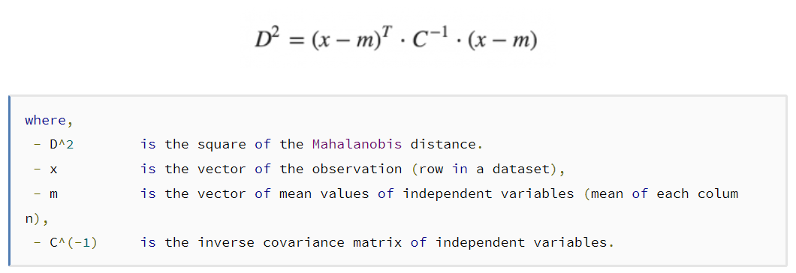
Mahalanobis Distance
Attributes correlated
Different ranges of values
Distribution of data – appr normal
Notes:
check https://people.revoledu.com/kardi/tutorial/Similarity/MahalanobisDistance.html
https://www.machinelearningplus.com/statistics/mahalanobis-distance/

Slide 18
Introduction
Mahalanobis distance is an effective multivariate distance metric that measures the distance between a point (vector) and a distribution.
It has excellent applications in
multivariate anomaly detection
classification on highly imbalanced dataset

Slide 19



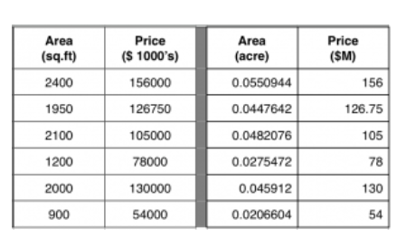


What’s wrong with using Euclidean Distance for Multivariate data?

Slide 20

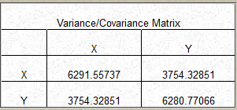


Slide 21
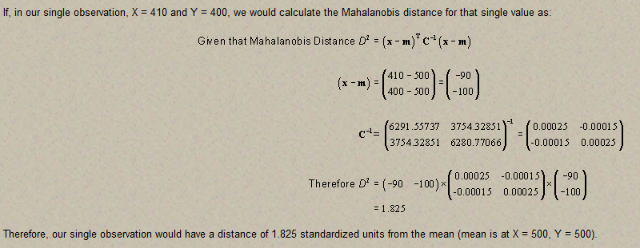

Slide 22
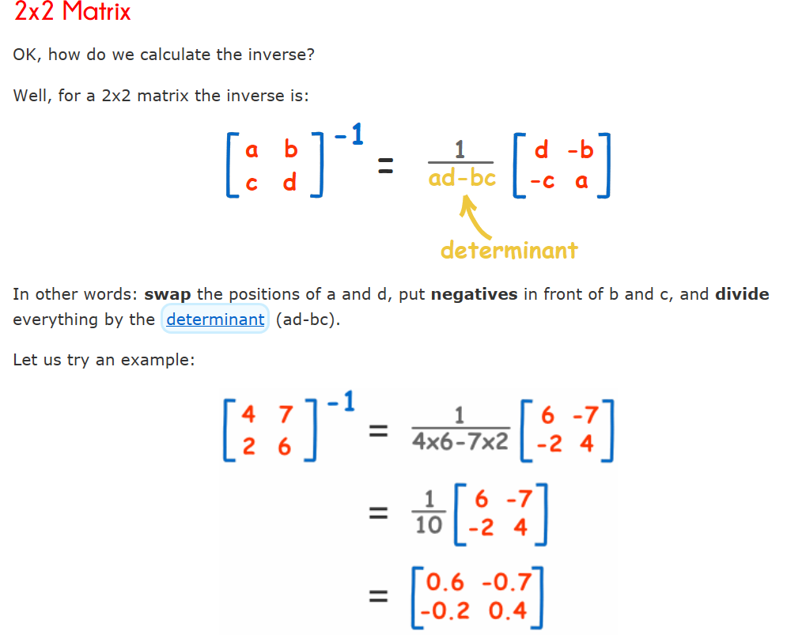

Slide 23


Slide 24
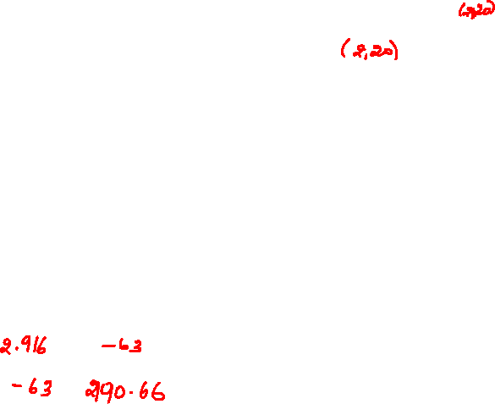

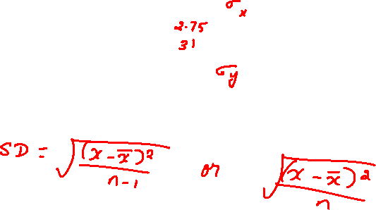
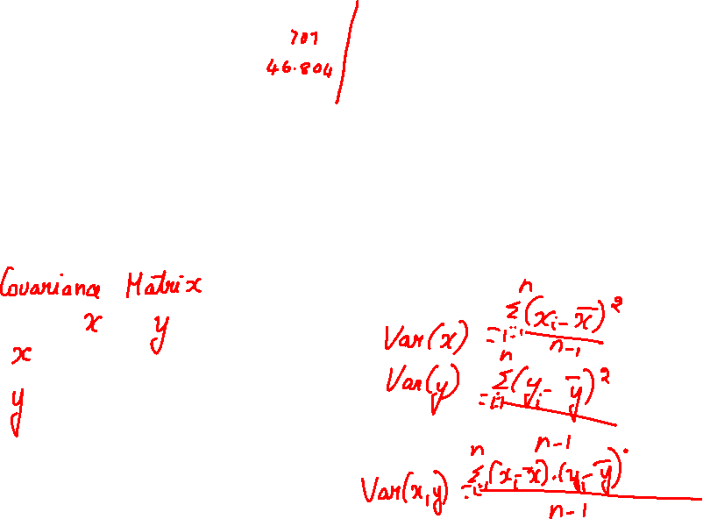
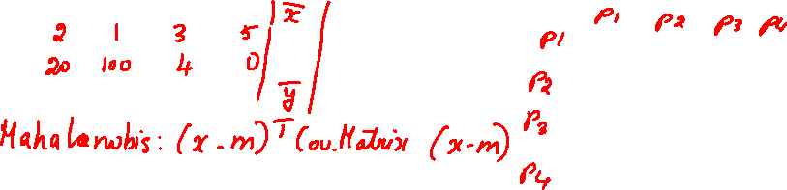

Slide 25
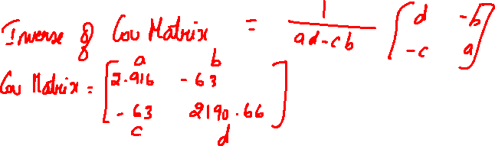

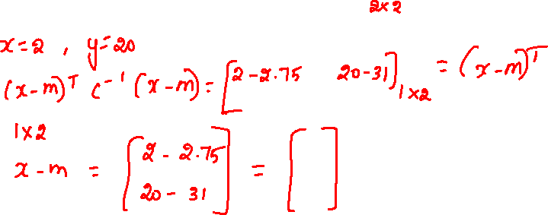
Inverse of Covariance Matrix
0.90506794 0.026028278
0.026028278 0.001205013

Slide 26
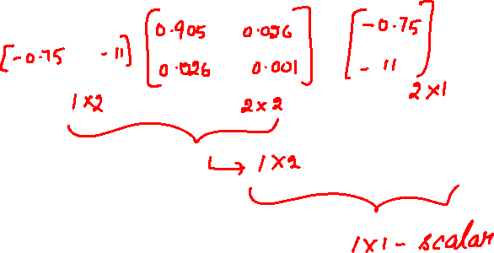
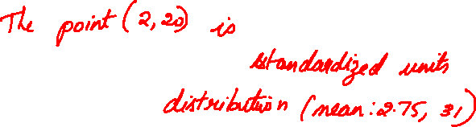
D² = 1.084374

Slide 27
Non-metric Similarity Measures

Slide 28
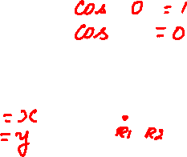
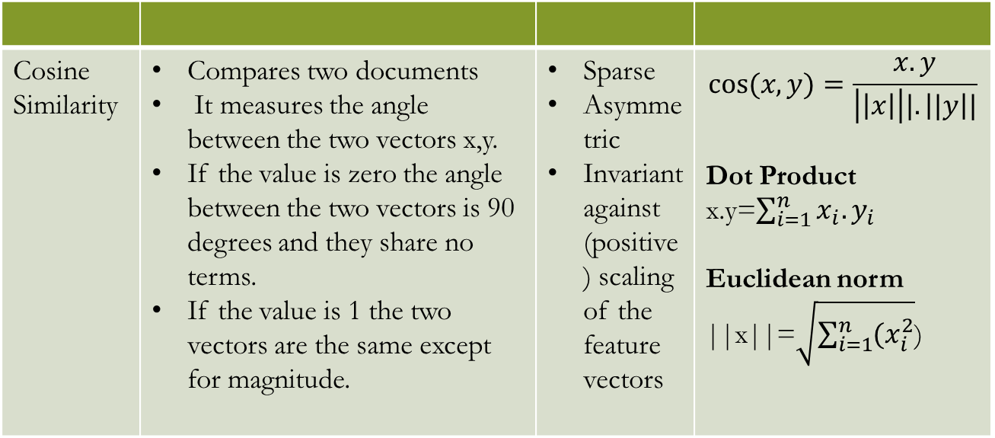
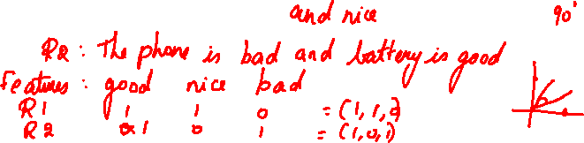

Cosine Similarity | Compares two documents It measures the angle between the two vectors x,y. If the value is zero the angle between the two vectors is 90 degrees and they share no terms. If the value is 1 the two vectors are the same except for magnitude. | Sparse Asymmetric Invariant against (positive) scaling of the feature vectors | $$cos⁡(x,y)=\frac{x.y}{\left|\left|x\right|\right||.\left||y\right||}$$ Dot Product x.y=$\sum_{i=1}^{n}{x_{i}.y_{i}}$ Euclidean norm ||x||=$\sqrt{\sum_{i=1}^{n}{{(x}_{i}^{2}}}$)

Slide 29
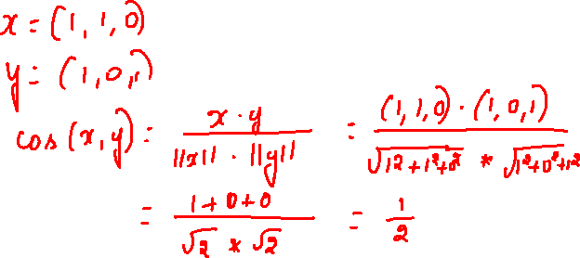

Slide 30
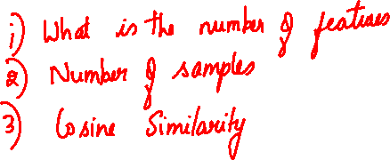
Cosine Similarity
Example:
d₁ = 3 2 0 5 0 0 0 2 0 0
d₂ = 1 0 0 0 0 0 0 1 0 2

Slide 31
Cosine Similarity
Example:
d₁ = 3 2 0 5 0 0 0 2 0 0
d₂ = 1 0 0 0 0 0 0 1 0 2
d₁ • d₂= 3*1 + 2*0 + 0*0 + 5*0 + 0*0 + 0*0 + 0*0 + 2*1 + 0*0 + 0*2 = 5
||d₁|| = (3*3+2*2+0*0+5*5+0*0+0*0+0*0+2*2+0*0+0*0)^{0.5} = (42) ^{0.5} = 6.481
||d₂|| = (1*1+0*0+0*0+0*0+0*0+0*0+0*0+1*1+0*0+2*2) ^{0.5} = (6) ^{0.5} = 2.245
cos( d₁, d₂ ) = .3150

Slide 32



Example – Invariant Positive Scaling of Cosine Similarity
Consider for example two cake recipes, one with 3 eggs, 1 1/2 cups sugar, 1 1/2 cups ﬂour, 1/2 cup butter, and the other one with 6 eggs, 3 cups sugar, 3 cups ﬂour, and 1 cup butter. Obviously, both recipes yield the same cake, but the second one yields twice as much cake as the ﬁrst one. Following the intuitive expectation the cosine similarity between the two recipes is equal to one.

Slide 33
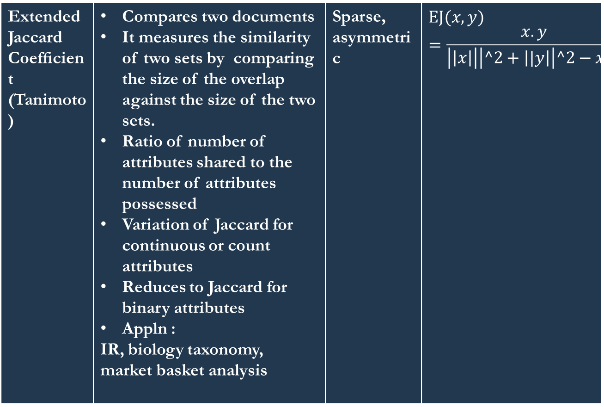
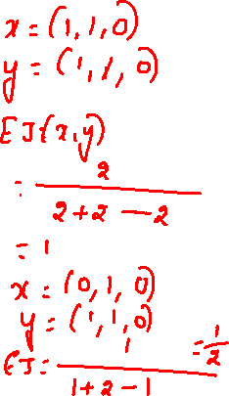
Extended Jaccard Coefﬁcient (Tanimoto) | Compares two documents It measures the similarity of two sets by comparing the size of the overlap against the size of the two sets. Ratio of number of attributes shared to the number of attributes possessed Variation of Jaccard for continuous or count attributes Reduces to Jaccard for binary attributes Appln : IR, biology taxonomy, market basket analysis | Sparse, asymmetric | $$EJ⁡(x,y)=\frac{x.y}{\left|\left|x\right|\right|\left|^2+\left||y\right|\right|^2−x.y}$$

Slide 34
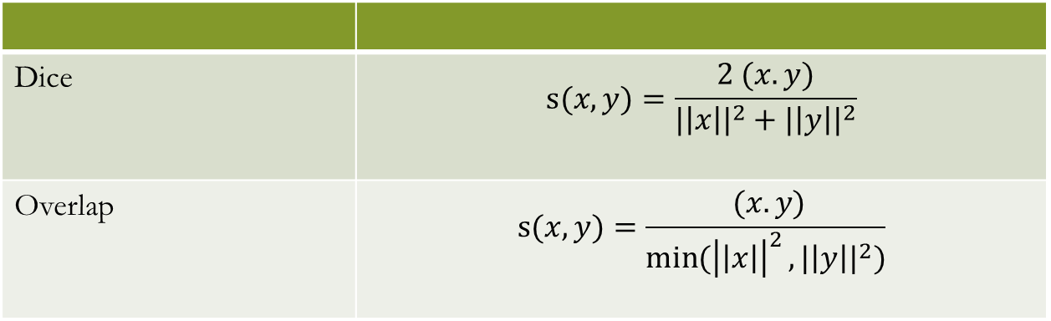
Dice | $$s⁡(x,y)=\frac{2 (x.y)}{{|\left|x\right||}^{2}+{|\left|y\right||}^{2}}$$
Overlap | $$s⁡(x,y)=\frac{ (x.y)}{\min{{(\left|\left|x\right|\right|}^{2}},{|\left|y\right||}^{2})}$$

Slide 35
Similarity between Columns of Data Matrix

Slide 36
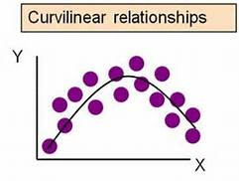
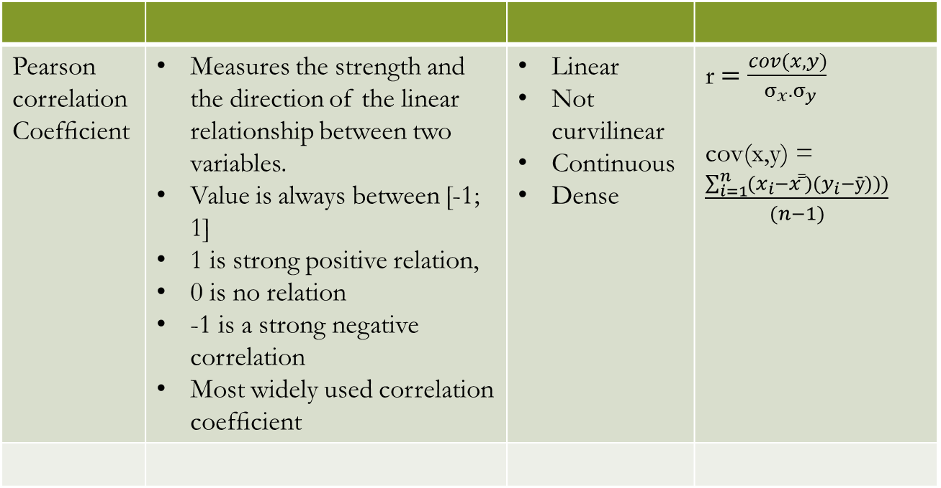
Pearson correlation Coefﬁcient | Measures the strength and the direction of the linear relationship between two variables. Value is always between [-1; 1] 1 is strong positive relation, 0 is no relation -1 is a strong negative correlation Most widely used correlation coefﬁcient | Linear Not curvilinear Continuous Dense | r$=\frac{cov(x,y)}{ σ_{x}.σ_{y}}$ cov(x,y) = $\frac{\sum_{i=1}^{n}{(x_{i}−xx̅̅)(y_{i}−ȳ))})}{(n−1)}$

Slide 37
Dense, continuous data
Euclidean distance
Sparse, asymmetric
Ignore 0-0 matches
Cosine, Jaccard, Tanimoto
Time series with same magnitude?
Euclidean
Time series with same shape?
Correlation

Slide 38
Dice vs Cosine
Dice checks for existence (set intersection), while cosine checks for a metric (scalar product). Let's ignore the denominator in both formulas since they serve the purpose of normalizing, and just take the numerators.

Slide 39
Dice vs Cosine
Talking about text documents, Dice simply checks if a word from a vocabulary is present in both documents A and B, however not for the frequency of the occurences. The Dice coefficient will therefore be the same between docs A1 = "boats" and A2 = "boats boats boats" and any other reference document B.
Cosine includes frequency by using the scalar product, and instead of doing a check if a word is present in both sets, it multiplies the frequencies of words in both documents (or some other related measure, a common one being tf-idf). Therefore, for a reference document B, the cosine score will be different for A1 and A2.

Slide 40
Cosine vs Jaccard
In cosine similarity, the number of common attributes is divided by the total number of possible attributes. Whereas in Jaccard Similarity, the number of common attributes is divided by the number of attributes that exists in at least one of the two objects.
The Cosine index could be used to identify plagiarism, but will not be a good index to identify mirror sites on the internet. Whereas the Jaccard index, will be a good index to identify mirror sites, but not so great at catching copy pasta plagiarism (within a larger document).

Slide 41
Sequence Relations

Slide 42
Applications
Sequences of daily temperature values at different locations
Text documents viewed as sequences of alphanumerical characters
Sequences of web pages visited by different users

Slide 43
Measures
Sequences of same length
Hamming distance
Sequences of different length
Levenshtein or edit distance

Slide 44
Levenshtein or edit distance
Given two character strings s and t,
the edit distance between them is
the minimum number of edit operations required to transform s into t.
s – along row, t – along column
Edit operations allowed
insert a character into a string
delete a character from a string and
replace a character of a string by another character

Slide 45
Step | Description
1 | Set n to be the length of s. Set m to be the length of t. If n = 0, return m and exit. If m = 0, return n and exit. Construct a matrix containing 0..m rows and 0..n columns.
2 | Initialize the first row to 0..n. Initialize the first column to 0..m.
3 | Examine each character of s (i from 1 to n).
4 | Examine each character of t (j from 1 to m).
5 | If s[i] equals t[j], the cost is 0. If s[i] doesn't equal t[j], the cost is 1.
6 | Set cell d[i,j] of the matrix equal to the minimum of: a. The cell immediately above plus 1: d[i-1,j] + 1. b. The cell immediately to the left plus 1: d[i,j-1] + 1. c. The cell diagonally above and to the left plus the cost: d[i-1,j-1] + cost.
7 | After the iteration steps (3, 4, 5, 6) are complete, the distance is found in cell d[n,m].

Slide 46
 |  |  | C | L | E | O | P | A | T | R | A
 |  | 0 | 1 | 2 | 3 | 4 | 5 | 6 | 7 | 8 | 9
 | 0 | 0 | 1 | 2 | 3 | 4 | 5 | 6 | 7 | 8 | 9
C | 1 | 1 | 0 | 1 | 2 | 3 | 4 | 5 | 6 | 7 | 8
A | 2 | 2 | 1 | 1 | 2 | 3 | 4 | 4 | 5 | 6 | 7
E | 3 | 3 | 2 | 2 | 1 | 2 | 3 | 4 | 5 | 6 | 7
S | 4 | 4 | 3 | 3 | 2 | 2 | 3 | 4 | 5 | 6 | 7
A | 5 | 5 | 4 | 4 | 3 | 3 | 3 | 3 | 4 | 5 | 6
R | 6 | 6 | 5 | 5 | 4 | 4 | 4 | 4 | 4 | 4 | 5
matrix[1,1] : cost = 0
Min{1+1,0+cost = 0+0, 1+1} = 0

